Slide 1
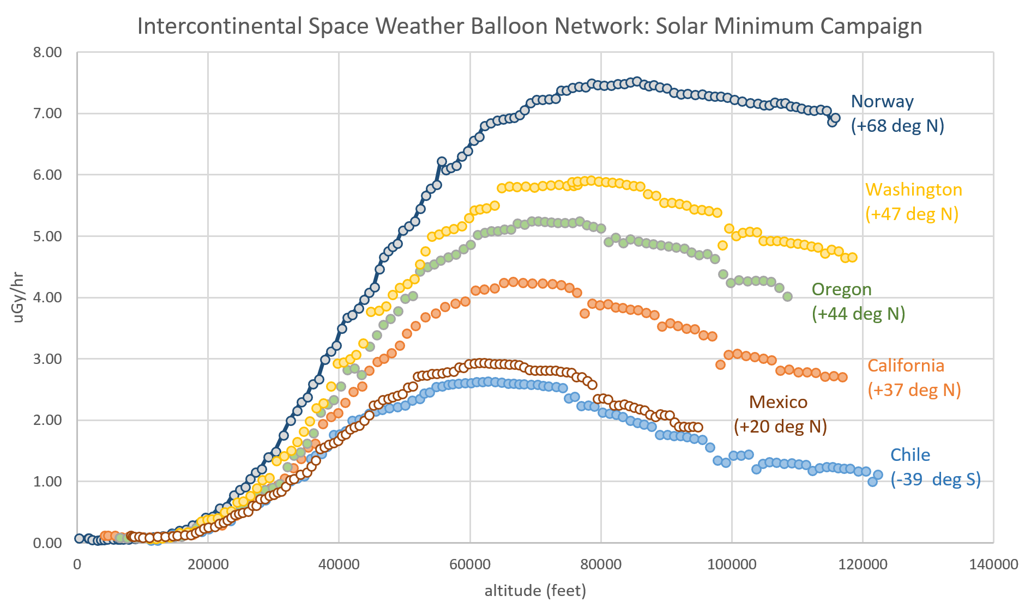

Interesting Title to Grab Attention
PH 250 – Intermediate Physics Lab
Authors
Background
Results
Ionizing radiation can be harmful to organisms at high levels. Life on earth is possible in part because the earth’s magnetic field and atmosphere shields the surface from most of this harmful radiation. This effect diminishes as altitude increases because the strength of the magnetic field and the density of the atmosphere decreases. Additionally, increased distance from the equator also is associated with reduction in shielding primarily due to magnetic shield strength. Several industries and research endeavors take place at high altitudes. For example, pilots and airplane staff spend long periods at over 30,000 ft at cruising speeds. Accurate radiation data can be collected over the state of Idaho to ensure individuals and equipment are exposed to safe levels of radiation.
Present the results of your work in a short readable format. Introduce the data, then let the graphs or tables do the heavy lifting.
Presenting data clearly in tables and graphs is important. Don’t forget axis labels, titles, legends, and subscripts if they are needed.
Objective
Earth to Sky Calculus is a youth research group that has been collecting radiation data at varying altitudes using weather balloons led by Dr Tony Phillips. Our goal was to gather radiation data at a similar latitude and altitudes as Dr Tony’s research group with the High Altitude Research Team (HART) weather ballon and compare data and confirm the accuracy of our collection methods.
Figure 1: (Above) The data collected by the Earth to Sky Calculus Research Group for radiation data vs altitude.
Discussion/Conclusions
Interpret the results, are they meaningful?
Did you succeed in your objective?
What would you do differently or include if you had more time on the project?
Design/Method
To collect this data, a simple Arduino powered Geiger-Muller Counter and barometer was equipped to the HART ballon. The Geiger-Muller Counter works on a sealed tube with electrodes that have voltage but no current. When ionizing radiation passes through the gas, current will temporarily flow through allowing the detection of radiation. The Barometer will allow us to measure altitude via the barometric formula.
Equation 1: (Above) Barometric formula, allowing the conversion of barometric data to altitude data.
The Arduino has been designed and coded such that it will simultaneously collect both barometric and radiation data. It then reports it to a data shield for later examination.
How will you reach the goals? What measurements will you take? Are there relevant Equations? Present this information here, but don’t overwhelm the reader.
Images, tables, and graphs may be better at conveying information than a wall of text.
References
Cite sources that were used in your work.
Use APA citation formatting
We don’t do physics alone! Include a picture of your team. A picture of your team with your project is even better.
We’re proud of our students and want to show of you and your work.
You can also include a subscript with your names and majors below the picture.

